Slide 1

JUPAI3:
File handling and data extraction
Assignment

Slide 2
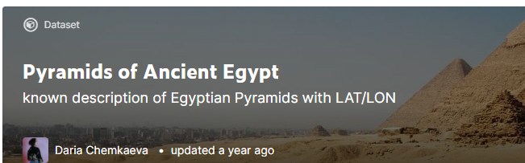
Question
Deal with Egyptian Pyramids CSV dataset.
https://www.kaggle.com/lsind18/egyptianpyramids
Prepare it and print the basic data about each pyramid.

Slide 3
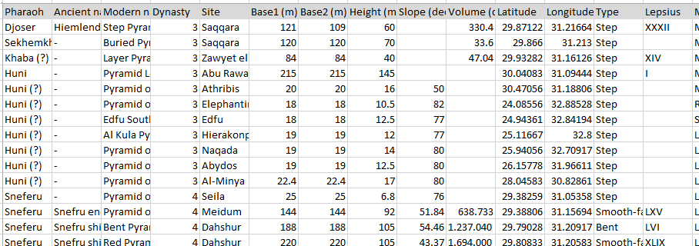
Question
Tasks:
Explore the dataset (CSV file) and understand it’s parts

Slide 4
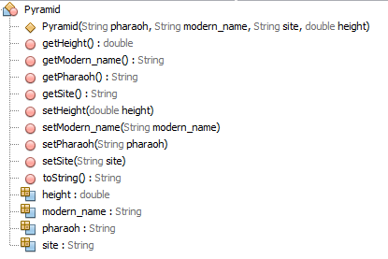
Question
Tasks:
Dataset preparation/transformation
Build a Pyramid class to define a prototype for all information you will extract from CSV for each pyramid.

Slide 5
Question
Tasks:
Dataset preparation/transformation
Build a PyramidCSVDAO class to:
Read pyramids.csv file.
Create List of Pyramids objects for each pyramid in the csv file
Do not forget to validate the values you make all needed conversion.

Slide 6
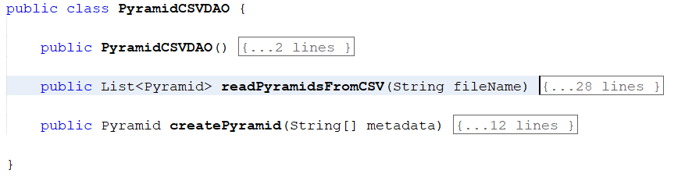
Question
Tasks:
Dataset preparation/transformation
Build a PyramidCSVDAO class to:

Slide 7
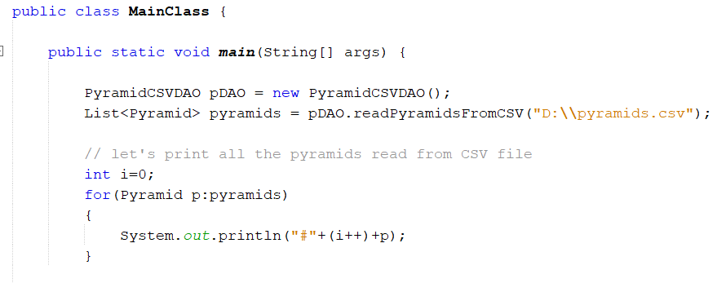
Question
Tasks:
Dataset preparation/transformation
Build a Main class to use PyramidCSVDAO class and print the basic data about each pyramid.

